Slide 1

Think Like a Certification Exam
William Assaf, Sparkhound

Slide 2
Pop Quiz
You are an admiral in Starfleet.
Your new flagship needs a captain. You may choose any out of the ranks of captains throughout time. The captain must have never willingly cooperated with the Borg. Because of the long voyage, the captain must have no children to leave behind. The new captain must have a superior hairstyle.
You need to choose a leader for your starship.
Who captain should you choose?
A. James T Kirk
B. Jean-Luc Picard
C. Benjamin Sisko
D. Kathryn Janeway

Slide 3
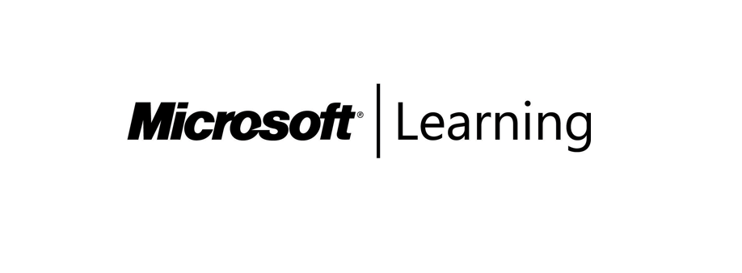
Summary
Gain exam insights, the best prep strategies, an test-taking strategies from a exam veteran and writer. Learn how to deconstruct questions and answers, how questions are written, and what certification exams are really testing for.
Who exams are for
How Exams are Written
Test-taking tips
Deconstructing the wrong answers
Sample exercises
Content is not specific to Microsoft technologies and exams, though that is where my experience lies as a consultant, as a certified pro, and as an exam item writer.

Slide 4
Certified Technology Professionals
Certified employees are 17% more productive.
Certified reduce unplanned downtime when problems arise by 56%
Certified employees are generally more satisfied with their jobs and enjoy tenures that are 15% longer than uncertified employees.
72% of employers require IT certifications for certain job openings
60% of employers use certifications to confirm subject matter expertise.
Source: Microsoft Learning White Paper http://download.microsoft.com/download/9/4/B/94B5442E-0494-4B42-A5DC-8742E4254B09/BVW-Microsoft-US40548315.pdf
CompTIA HR Perception of IT Training and Certification Study: 2015
https://certification.comptia.org/docs/default-source/downloadablefiles/hr-perceptions-of-it-training-and-certification.pdf

Slide 5
What Exams Try to Test
When deciding on exam content, SME’s are asked: “Is this a skillset that you do regularly?” or “Is this a skillset you would ask for when hiring?”
If a worldwide group of a dozen SME’s does not think a feature is important, it’s not on the exam.
However, new features for new versions are likely to be included on the exam, to certify people working in the newest version(s).

Slide 6
Guidance for Employers
Microsoft exams are designed to test experience, not book knowledge.
So asking a kid out of college or an entry-level employee to take a cert exam is not something I advise. It leads to one of three outcomes:
They pass the exam. (Least likely)
More likely:
They fail the exam, possibly multiple times, resulting in frustration/disillusionment, even career derailment.
They try to cheat. Outcomes dubious.

Slide 7
Certs and Your Employees
Employers:
Exams are targeting people with at least 2+yrs real experience
Some exams are intended for 5+yrs of experience
Don’t have unrealistic expectations of entry-level employees
Put cash bounties on exams, but with no time limit
Pay the exam fees. Even if they fail.
Incentivize your employees to take exams for right reasons
Reward success but not to excess. Career progress should also occur outside of exam

Slide 8
Certs and Your Employees
Microsoft does have some “Fundamentals” level exams that are not in the MCSE path, but rather the MTA (Technology Associate) path.
These may be more appropriate for incentivizing entry-level employees without the yrs targeted for the MCSA/MCSE path.
More appropriate for students, entry-level positions, or preparing for a career change.
Examples:
Exam 98-349 Windows Operating System Fundamentals
Exam 98-364 Database Fundamentals
Exam 98-382 Introduction to Programming Using JavaScript
Exam 98-369 Cloud Fundamentals
https://www.microsoft.com/en-us/learning/mta-summary-certification.aspx

Slide 9
How to Train an Employee
Employers:
Classroom training overrated, lengthy, hit-and-miss.
Travel conferences are expensive, lengthy.
Require knowledge transfer afterwards.
Proof of hands-on-lab completion when sending employees off. No hands-on labs? Be skeptical. :/
Employees should take advantage of the easy free training opportunities to earn expensive paid ones (Hint: This. Event. Right. Now.)

Slide 10
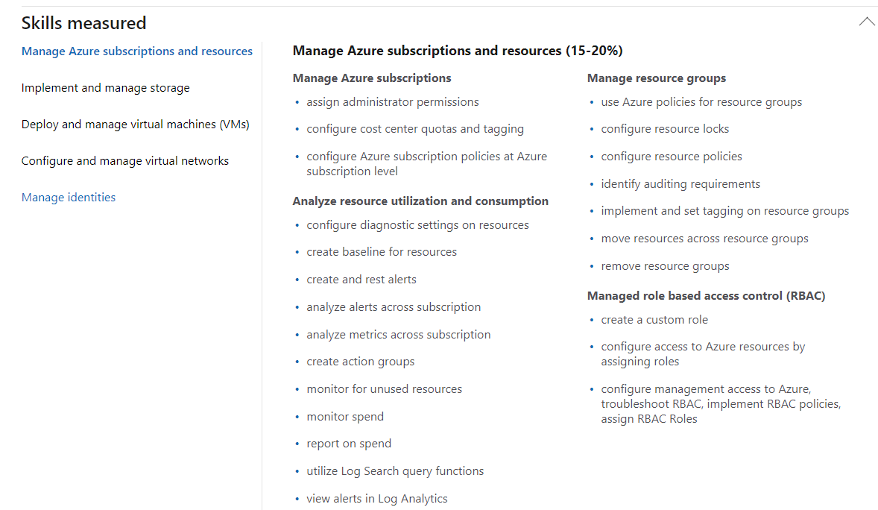
So What Is On a Cert Exam?
Straight from Microsoft.com, this is the “Skills Measured” section, this is the “domain”.
The “domain” is determined by a group of SME’s before item writing begins, validated by real-life experience.
The “domain” tells the item writer what write about.

Slide 11
How To Prepare for Cert Exams
Study by doing.
For example:
If you have a book, take a practice exam
Look at the review questions on a book, or use the syllabus, test unfamiliar features for yourself.
If something is not familiar, or if you get the practice question wrong, go lab it out.

Slide 12
How To Prepare for Cert Exams
Study by doing.
This almost certainly requires a lab environment at home or work where you can tinker, break, fix, build, tear down, and learn.
Don’t have a test lab? Build one, it’s educational.
Have a lab environment installed on your work/home PC’s, or use Azure. (Free credits out there for students, new accounts, MSDN, etc.)

Slide 13
How To Prepare for Cert Exams
Do not study only by reading books/MSDN.
Memorization is rarely tested on cert exams.
Though, you must know the subject material.
Proper feature choice and solution approach are more likely to be tested.
Code sample questions are likely to test order of operations and correct tactic choice, not syntax.

Slide 14
What Exams Try to Test
The exams are highly situational.
So instead of asking "What is the difference between x and y."
The question will be: You are doing this with these conditions and variables. What should you choose. a. X b. Y c. Z d. Q

Slide 15
Real Answer Options
The correct answer has to be 100% correct. The "distractors" have to be plausible, but 100% wrong.
But we can't make stuff up. Every answer you see is something real. We write plausible real wrong answers.
In SQL Server, there is no “CHECKSUM Recovery Model” so you won’t see it on an exam.

Slide 16
Solutions Providers, Not Exam Takers
Microsoft’s recent Emphasis is on Solutions. Example:
To get SQL MCSA (three exams), you need to know how to build end-to-end Business Intelligence, with lots of SSIS (including Data Quality Services), SSRS, even SSAS, in addition to the expected database admin and querying.
There is no such thing as a one-dimensional certification because there are few cases of one-dimensional jobs.
This is intentional and raises the value of a certification – a certification should mean you have broad experience.
Notes:
About 14 minutes

Slide 17
Item Writers are SME’s
Let’s talk about who creates the exams. Microsoft subcontracts out SME’s globally.
Focus on practicality and actual usage.
Topics are removed from the exam’s domain if none of the SME’s present could say they use it in real life.
Then, how many of each domain should be there?
Then, provide some sample topics for the item writers.

Slide 18
Item Writers are SME’s
Item Writers are given assignments to cover a narrow domain.
Item Writer team must make sure they’re not overlapping or
creating nemeses that giveaway answers to other questions.
Then a review process and alpha exam process occur with yet another group of SME’s to fine tune the items.

Slide 19
Fun With Grammar
What "should you use" not "could use" or "would use“
"You need to" not "you must“
"By using" not "using“
"Named" not "called“
"You are developing" not "you are working on“
"by using the least amount of administrative effort" not "most efficiently" or "best” or “of course you’d do it this way”
"server that runs SQL Server" not "running SQL“ or “SQL server”
Also, if the word/phrase doesn't translate well, don't use it.

Slide 20
Fun With Grammar
The word "only" is a pain. It has to be exact. Think translation!
Tonight we are serving enchiladas only. – that’s it for the menu
Tonight we only are serving enchiladas. – nobody else makes em
Tonight only we are only serving enchiladas. – tomorrow? Nope.
The "application only connects to one database"
vs.
the "application connects to only one database"

Slide 21
“Best Practices”
Never assume a question is asking you for the “Best Practice.”
Something in the question will make the other answers wrong.
“Best Practices” are not testable, but may be used as distractors. We can’t test:
unenforced naming conventions or
generally accepted standard or
the normal order for this or
how it has always been done or
“industry knowledge” or
“never use GUIDs”

Slide 22
After the exam is live
Question success is statistically analyzed by a psychometrician
Do candidates who pass get this question right? Good.
Do candidates who pass get this question wrong? Not good.
Is question success unrelated to this exam success? They’re guessing.
Your comments on the exam are reviewed, by name.
Be professional.
Your comments can contribute to changing/abandoning a question.
"Why are you testing this? I'd look this up!"

Slide 23
After the exam is live
Exams can be refreshed for new content.
For example, the SQL 2012 exams were updated with 2014 content.
Then, new SQL 2016 exams with new numbers were written from scratch, and later updated in 2017 for new content including Azure.
New product capabilities/features often get a special focus on exams.

Slide 24
Writing the Wrong Answers Is Most Difficult
If two answers seem correct, there IS a differentiator somewhere in the question.
Read the question carefully, note details.
At some point, the question writer introduced a factor in the question to make sure there is only one right answer and all other options are 100% wrong.

Slide 25
Writing the Wrong Answers Is Most Difficult
Writing the right answer is easy, and its polar opposite is easy (though sometimes too obvious).
Writing wrong answers is more difficult than correct answers!
Creating challenging wrong answers sometimes involves introducing new variables or twists to your question, and it is difficult to keep the question scenario simple.

Slide 26
Item Writer - Question Drifting
“Domain Drift” is when your question became so complicated,
you end up with a question on a different topic.
Now you have to beg another Item Writer to trade question assignments with you.

Slide 27
Item Writer - Question Drifting
For example, if you were supposed to ask a question about peanut butter sandwiches, and ended up asking a question about which whether utensils can spread creamy peanut butter…

Slide 28
Question Structure
A question will include:
a Technical Scenario,
a Problem Statement and Requirements,
a Goal Statement,
and a Question Statement.
For example:
You are making a sandwich.
You must make the sandwich with peanut butter.
You need to choose a utensil.
Which do you choose?

Slide 29
Writing the Wrong Answers Is Most Difficult
So your easy multiple choice answers become:
Fork.
Spoon.
Knife.
Spork.
And everyone knows a knife is correct, right?
For example:
You are making a sandwich.
You must make the sandwich with peanut butter.
You need to choose a utensil.
Which do you choose?

Slide 30
Writing the Wrong Answers Is Most Difficult
But you can probably spread peanut butter with any of those, if you try hard enough. You cannot test “Best Practices” or “Industry Standards” for peanut butter distribution. So you change your Goal Statement.
For example:
You are making a sandwich.
You must make the sandwich with peanut butter.
You need to choose a utensil that will spread the peanut butter by using the least amount of administrative effort.
Which do you choose?

Slide 31
Writing the Wrong Answers Is Most Difficult
But says who?
Spoons and Sporks have virtually the same peanut butter delivery factors,
and it could be argued by some cultures that forks are the superior peanut butter-handling implements.
For example:
You are making a sandwich.
You must make the sandwich with peanut butter.
You need to choose a utensil that will spread the peanut butter by using the least amount of administrative effort.
Which do you choose?

Slide 32
Writing the Wrong Answers Is Most Difficult
So you complicate your question to test the exam-takers peanut butter solutions delivery experience…
For example:
You are making a sandwich.
You must make the sandwich with peanut butter and cut the sandwich in half using the same utensil.
You need to choose a utensil that will spread the peanut butter by using the least amount of administrative effort.
Which do you choose?

Slide 33
Writing the Wrong Answers Is Most Difficult
Now spoons are definitely out. You can’t cut bread with a spoon, it’s science.
But sporks and forks? Those could still get the job done, as well as a knife.
But spork and fork are not 100% wrong (yet)!
So you change your question again…
For example:
You are making a sandwich.
You must make the sandwich with peanut butter and cut the sandwich in half using the same utensil.
You need to choose a utensil that will spread the peanut butter by using the least amount of administrative effort.
Which do you choose?

Slide 34
Writing the Wrong Answers Is Most Difficult
Now spoons are definitely out. You can’t cut bread with a spoon, it’s science.
But sporks and forks? Those could still get the job done, as well as a knife.
But spork and fork are not 100% wrong (yet)!
So you change your question again…
For example:
You are making a sandwich.
You must make the sandwich with peanut butter and cut the sandwich in half using the same utensil. You do not have access to a hybrid utensil environment.
You need to choose a utensil that will spread the peanut butter by using the least amount of administrative effort.
Which do you choose?

Slide 35
Writing the Wrong Answers Is Most Difficult
Boom, now Sporks are CLEARLY not allowed (for no good real-life reason, only one made up for this question). An answer is made 100% wrong.
But forks remain a problem…
For example:
You are making a sandwich.
You must make the sandwich with peanut butter and cut the sandwich in half using the same utensil. You do not have access to a hybrid utensil environment.
You need to choose a utensil that will spread the peanut butter by using the least amount of administrative effort.
Which do you choose?

Slide 36
Writing the Wrong Answers Is Most Difficult
There’s no way you could spread creamy peanut butter with a fork, right?
Ta Da!
Sigh.
And that’s why cert exam questions take FOREVER to read.
For example:
You are making a sandwich.
You must make the sandwich with creamy peanut butter and cut the sandwich in half using the same utensil. You do not have access to a hybrid utensil environment.
You need to choose a utensil that will spread the peanut butter by using the least amount of administrative effort.
Which do you choose?

Slide 37
Writing the Wrong Answers Is Most Difficult
Notice all the little details that may seem extraneous at first.
This isn’t a question about sandwiches. This isn’t really even a question about peanut butter.
It’s a question about the details of solution selection.
For example:
You are making a sandwich.
You must make the sandwich with creamy peanut butter and cut the sandwich in half using the same utensil. You do not have access to a hybrid utensil environment.
You need to choose a utensil that will spread the peanut butter by using the least amount of administrative effort.
Which do you choose?

Slide 38
Item Writer - Question Drifting
What did we start writing and answer about?
Utensils
What did we end up writing a question about?
Bread geometry, peanut butter viscosity.

Slide 39
Give it a Try
Let’s give it a shot!

Slide 40
Remember this?
You are an admiral in Starfleet.
Your new flagship needs a captain. You may choose any out of the ranks of captains throughout time. The captain must have never willingly cooperated with the Borg. Because of the long voyage, the captain must have no children to leave behind. The new captain must have a superior hairstyle.
You need to choose a leader for your starship.
Who captain should you choose?
A. James T Kirk
B. Jean-Luc Picard
C. Benjamin Sisko
D. Kathryn Janeway

Slide 41
Question 2
You are the sports director of a small college.
The dean has instructed you to grow the athletic program. You must choose a new varsity sport that uses spherical balls. The sport must be able to sell tickets in the university’s outdoor grass turf venue to anyone.
You need to choose a new sport program.
What sport should you choose?
A. Basketball
B. Baseball
C. Football
D. Quidditch

Slide 42
Question 3
You are the reel operator of a local cinema.
You must prepare a private showing of a film for a corporate event. The film must be a science fiction film featuring both alien(s) and android(s). You must not choose a film that features any raccoon(s).
You need to choose a film for the screening.
Which film should you screen?
A. Guardians of the Galaxy Vol 2
B. Blade Runner
C. Interstellar
D. Aliens

Slide 43
Question 4
You are the bartender of a local fine dining establishment.
You are instructed to serve an appropriate spirit to a diner. Your establishment only serves whiskeys aged in American oak barrels. The diner has requested a malt whiskey from outside of Tennessee. The malt must not contain corn.
You need to choose a spirit.
Which spirit should you serve?
A. Scotch
B. Bourbon
C. Tennessee Whiskey
D. Cognac

Slide 44
Question 5
You are the social media director for a cool hip company.
Your new marketing campaign much choose a social media platform. The social media platform must be persistent online forever. The grandmother of the CEO must not be aware of the platform. The platform must currently have accelerating growth.
You need to choose a social media platform.
Which platform should you choose?
A. Facebook
B. Twitter
C. Instagram
D. Snapchat

Slide 45
Question 6
You are an astronaut looking to land on a planet in this solar system.
Your new space base requires a solid surface. Your space base is equipped with a moon roof.
You need to choose a location for your new space base.
Which planet should you choose?
A. Jupiter
B. Venus
C. Pluto
D. Mars

Slide 46
Helpful Links
http://www.sqltact.com/2012/04/certification-exams-from-other-side.html
http://www.sqltact.com/2016/07/training-to-do-list-for-new-dba.html
https://borntolearn.mslearn.net/b/weblog/archive/2014/03/10/certification-update-sql-server-2014
https://mva.microsoft.com/
https://www.microsoft.com/learning/en-us/exam-70-463.aspx
https://www.microsoft.com/en-ca/learning/sql-certification.aspx
https://www.microsoft.com/en-us/learning/exam-98-364.aspx

Slide 47
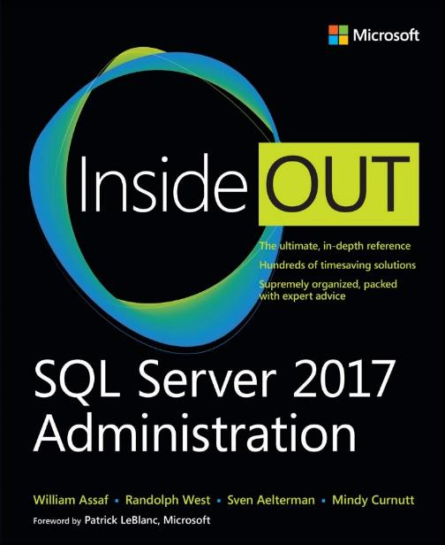
www.microsoftpressstore.com

Slide 48
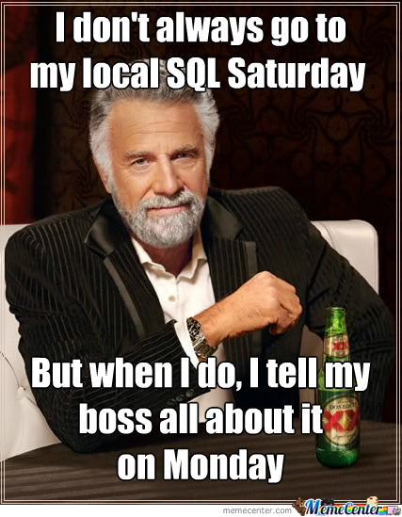

Slide 49



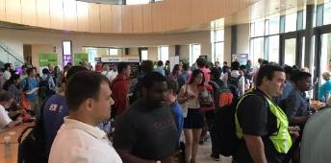

Free SQL Server, .NET, Business Intelligence training and more!
An all day FREE training event with SQL Server and Development related sessions spread out over multiple tracks of Business Intelligence, SQL Development,
Database Administration, IT Pro, .NET,
Career Development, and CIO/IT Management
See you August 17 at
SQLSatBR.com

Slide 50

Bio and contact
William D Assaf, MCSE
Baton Rouge SQL Server UG board and SQLSat chair
Principal Consultant, Manager – DBA Team at
Sparkhound Inc.
William.Assaf@sparkhound.com
Twitter: @william_a_dba
This presentation, including all source code, available at this SQLSaturday’s schedule page and at my blog:
SQLTact.com

